Slide 1

Lecture 4: Optimism and Pessimism in Ethical Thought
Instructor: Ali Raza Abbass
MBA (UK), PGD. Strategic Management & Leadership (UK), BBA (Pak)
Certified Digital Marketer (META, Google, DMI UK)
Master Trainer

Slide 2

The Eternal Debate

Slide 3

Optimism
Optimism: A general tendency to expect good outcomes or to focus on the positive aspects of a situation. It's not mere wishful thinking but often involves a belief in one's ability to influence future events positively.
Dispositional Optimism: A stable personality trait reflecting a general expectation that good things will happen.
Key Characteristics: Hope, resilience, positive expectation, proactivity, belief in progress.
Ethical Link: Can foster courage, promote perseverance in the face of injustice, and inspire collective action for positive change.

Slide 4

Pessimism
Pessimism: A general tendency to expect bad outcomes or to focus on the negative aspects of a situation. Often characterized by a belief that things will go wrong, or that efforts are futile.
Dispositional Pessimism: A stable personality trait reflecting a general expectation that bad things will happen.
Key Characteristics: Cynicism, caution, skepticism, resignation, focus on potential threats and failures.
Ethical Link: Can promote critical thinking, prevent naive idealism, and encourage preparedness for potential dangers or setbacks. Can also lead to inaction or despair.

Slide 5
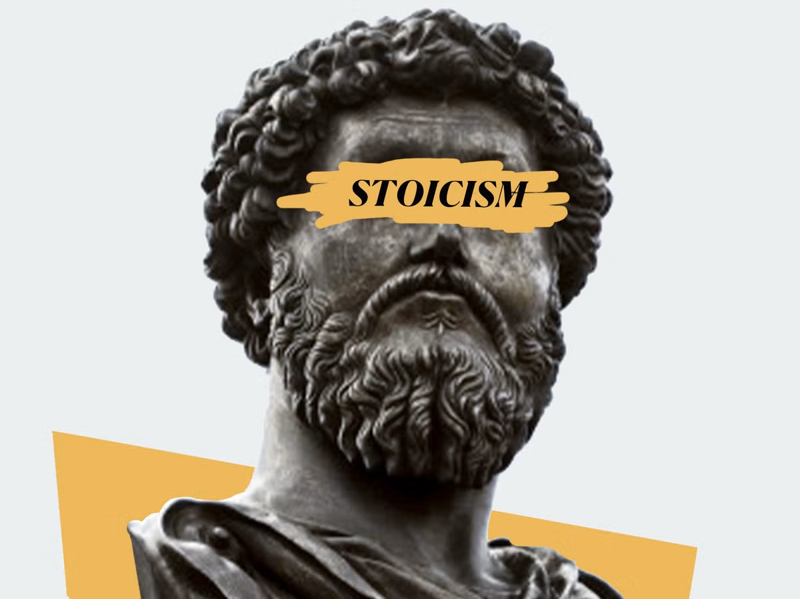
Famous Philosopher's Views - Ancient Roots
Stoicism (Seneca, Marcus Aurelius): While not explicitly "pessimistic," Stoicism advocates for accepting what cannot be changed and focusing on what is within one's control. It teaches amor fati (love of fate) and emphasizes virtue regardless of external circumstances. This can be seen as a realistic, perhaps even a "prepared pessimism," where one anticipates challenges to build resilience.
Ethical Implication: Cultivating inner peace and virtue, detaching from uncontrollable outcomes.
Epicureanism (Epicurus): Sought to achieve ataraxia (freedom from disturbance) and aponia (absence of pain). While often misconstrued, Epicureanism advocated for simple pleasures and minimizing pain, not boundless optimism. A careful, somewhat cautious approach to life's pleasures and pains.
Ethical Implication: Pursuit of moderate, sustainable happiness and avoidance of unnecessary suffering

Slide 6

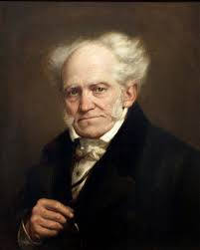
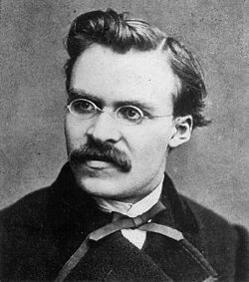
Famous Philosopher's Views - Enlightenment & Beyond
Immanuel Kant (Optimistic Rationalism): Believed in the power of human reason to establish universal moral laws (Categorical Imperative) and achieve moral progress. His philosophy inherently carries an optimistic view of human potential for good and rational self-governance.
Ethical Implication: Duty-bound actions based on reason, belief in moral autonomy and progress.
Arthur Schopenhauer (Profound Pessimism): Argued that life is inherently suffering, driven by a blind, irrational "Will." Happiness is merely the temporary absence of pain. Saw existence as a constant striving and suffering.
Ethical Implication: Compassion for the suffering of others (shared human condition), asceticism, denial of the Will as a path to peace.
Friedrich Nietzsche (Active Pessimism/Tragic Optimism): Criticized Schopenhauer's passive pessimism. Acknowledged the suffering and meaninglessness of existence (nihilism) but called for an affirmation of life despite it, creating one's own values and meaning. Embracing struggle as a path to self-overcoming (Will to Power).
Ethical Implication: Radical individualism, self-creation, courage in the face of existential absurdity, challenging conventional morality.

Slide 7
Impacts on Youth - The Optimistic Path
Positive Outcomes:
Mental Well-being: Lower rates of depression and anxiety, higher self-esteem.
Academic Achievement: Greater persistence, better problem-solving skills, higher motivation.
Physical Health: Better coping mechanisms, stronger immune system, healthier lifestyle choices.
Social Development: Stronger relationships, better conflict resolution, greater empathy.
Resilience: Ability to bounce back from setbacks, view challenges as opportunities for growth.
Ethical Implications: Fosters a proactive approach to personal and societal challenges, encourages engagement and belief in the possibility of positive change.

Slide 8
Impacts on Youth - The Pessimistic Path
Negative Outcomes (if unchecked):
Mental Health: Increased risk of depression, anxiety, learned helplessness, apathy.
Academic Performance: Lower motivation, decreased effort, avoidance of challenging tasks.
Physical Health: Increased stress, poorer health choices, higher rates of illness.
Social Isolation: Difficulty forming connections, cynicism towards others' intentions.
Disengagement: Resignation, belief that individual efforts are futile, leading to inaction.
Ethical Implications: Can lead to moral paralysis, a retreat from responsibility, or a justification for inaction in the face of injustice due to a belief in futility.

Slide 9
The Ethical Challenge: Naiveté vs. Cynicism
The Optimist's Blind Spots:
Naiveté: Underestimation of risks, oversimplification of complex problems, unrealistic expectations.
Lack of Preparedness: Failure to anticipate and plan for negative outcomes.
Dismissal of Valid Concerns: Overlooking genuine threats or suffering in pursuit of a positive narrative.
Ethical Risk: Unintended harm due to lack of foresight, overlooking systemic issues.
The Pessimist's Pitfalls:
Cynicism/Nihilism: Belief that nothing matters, leading to apathy or destructive behavior.
Learned Helplessness: Giving up before trying, belief that efforts are futile.
Self-Fulfilling Prophecy: Negative expectations leading to negative outcomes.
Ethical Risk: Inaction in the face of injustice, erosion of hope, justifying harm through perceived meaninglessness.

Slide 10
Scientific Research Findings on Optimism & Pessimism
Cognitive Biases:
Optimism Bias (Unrealistic Optimism): People tend to overestimate the likelihood of positive events and underestimate the likelihood of negative events happening to them. This can lead to risky behaviors but also boosts motivation.
Confirmation Bias: Individuals seek out and interpret information that confirms their existing beliefs (optimistic or pessimistic).
Psychological Studies:
Learned Helplessness (Seligman): Pioneering work showed that repeated exposure to uncontrollable negative events can lead to a sense of helplessness and pessimism, even when control is later possible.
Personality Psychology: Optimism and pessimism are often measured as stable personality traits using scales like the Life Orientation Test-Revised (LOT-R).
Health Psychology: Longitudinal studies consistently link optimism to better physical health outcomes (e.g., cardiovascular health, immune function) and increased longevity. Pessimism is associated with higher stress levels and increased risk of chronic diseases.
Developmental Psychology: Research indicates that explanatory styles (optimistic vs. pessimistic) can be influenced by parenting styles, educational experiences, and early life events

Slide 11
Solutions - Cultivating Ethical Perspectives
Balanced Realism: Encourage a pragmatic view that acknowledges challenges while maintaining hope and agency. This is not about blind optimism or paralyzing pessimism.
Critical Optimism: Promote hope that is grounded in evidence and critical analysis, recognizing barriers while actively seeking solutions.
Constructive Pessimism: Use skepticism and foresight to identify potential problems and prepare for them, rather than to justify inaction.
Fostering Resilience: Teach coping mechanisms, problem-solving skills, and adaptive thinking.
Emphasis on Agency and Responsibility: Remind youth that while external circumstances exist, they have the power to choose their response and contribute to change.
Ethical Action: Emphasize that both optimism and pessimism can lead to ethical or unethical actions depending on how they are channeled. The key is to act with intention and responsibility.

Slide 12
That’s all for today folks!!

